Slide 1
Predictive maintenance
Axbit University

Slide 2
Outline
Predictive maintenance – What and why
Introducing case example
Our solution
Results

Slide 3
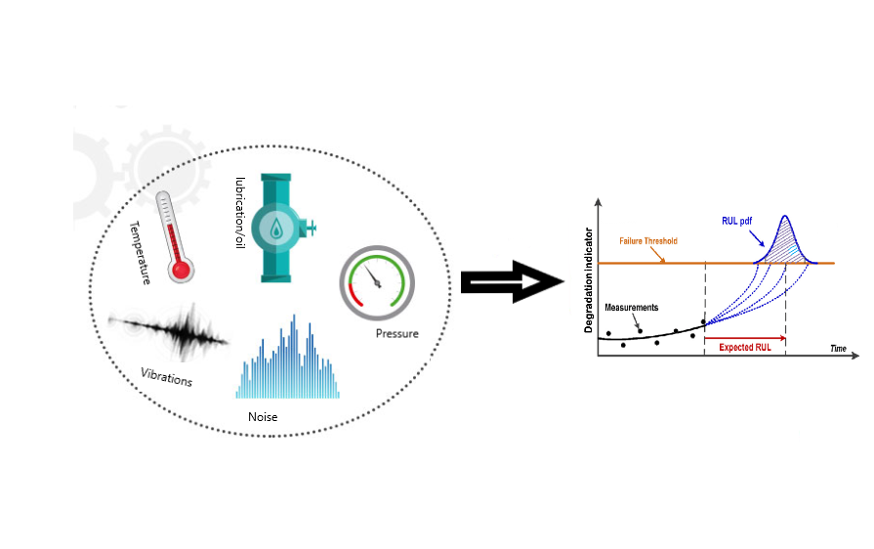
Predictive maintenance
Data driven proactive maintenance strategy based on condition monitoring to detect degradation of the equipment and predict when the maintenance should be performed.
Sensors
(real-time performance data)
IoT
(Enables communication b\w equipment and software solution)
Predictive models
(model to spit out failure predictions)

Slide 4
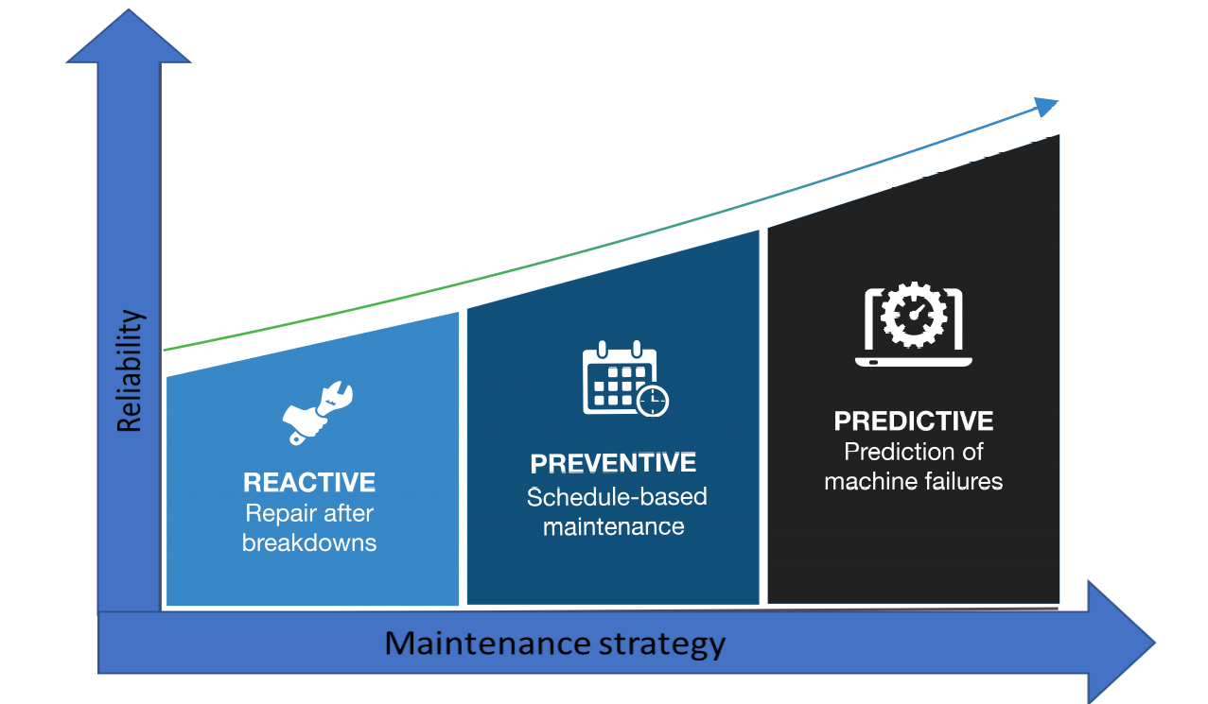
Predictive maintenance: Why
Reduced downtime
Asset availability
Increased equipment lifespan
Increased production capacity
Predictive maintenance
Improve workforce
Decreased planned maintenance
Lower risk
Smart replacement

Slide 5
Relevancy for Axbit
Many potential clients have or planning to generate time series sensors data
Showcase a predictive maintenance competence

Slide 6
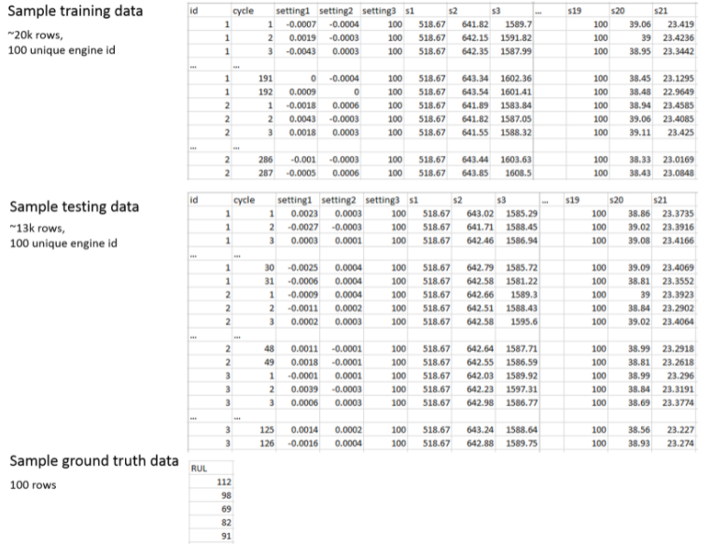
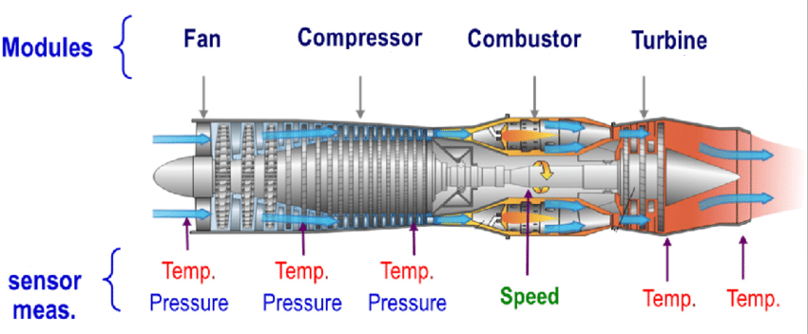
Predictive maintenance – Case example
Data source
https://gallery.azure.ai/Experiment/Predictive-Maintenance-Step-1-of-3-data-preparation-and-feature-engineering
https://ti.arc.nasa.gov/tech/dash/groups/pcoe/prognostic-data-repository/ -- Turbofan engine degradation simulation dataset

Slide 7
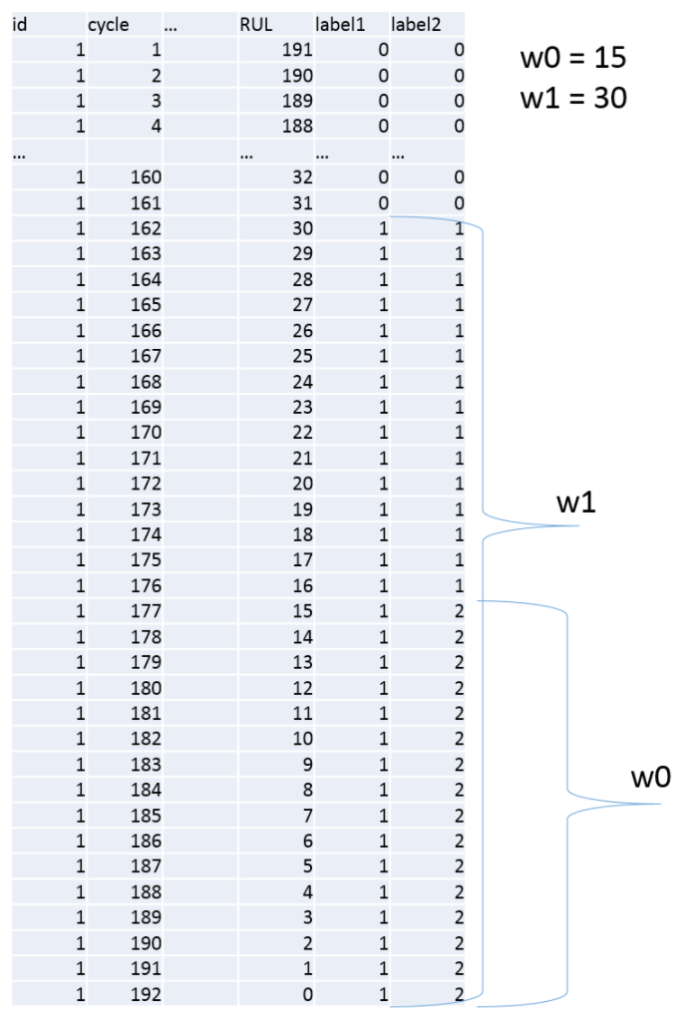
Predictive maintenance In-service aircraft engine
Regression: Predict the Remaining Useful Life (RUL).
Binary classification: Predict if an in-service engine will fail within certain time frame.
Multi-class classification: Predict if an in-service engine will fail in two different time windows.

Slide 8
Azure ML Team’s solution (Using Azure machine learning studio)

Slide 9
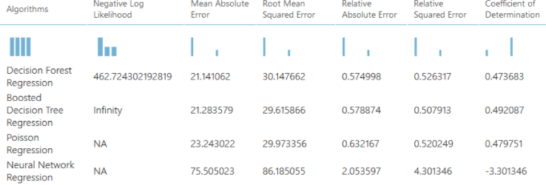
Predictive maintenance
Predict the Remaining Useful Life (RUL).
Predict if an in-service engine will fail within certain time frame.
Predict if an in-service engine will fail in two different time windows.

Slide 10
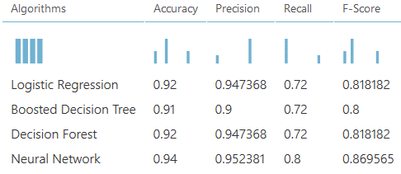
Predictive maintenance
Predict the Remaining Useful Life (RUL).
Predict if an in-service engine will fail within certain time frame.
Predict if an in-service engine will fail in two different time windows.

Slide 11
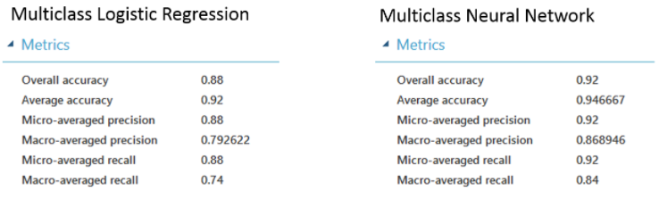
Predictive maintenance – Case example
Predict the Remaining Useful Life (RUL).
Predict if an in-service engine will fail within certain time frame.
Predict if an in-service engine will fail in two different time windows.

Slide 12
Axbit’s Solution

Slide 13
Time series data and machine learning
Recurrent neural network has recurring connection to itself:
Learns temporal dependence: Gives a sense of time context that can change dynamically.
Native support for sequential dependencies.
RNN’s are less brittle towards time dependent nonlinearities.
Recurrent neural network
Feed-forward neural network
Feed-forward ML methods may still work If data is time stationary.

Slide 14
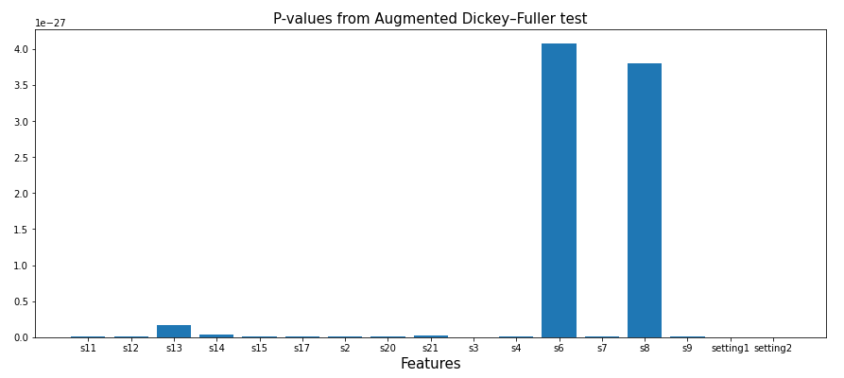
Predictive maintenance – Axbit’s solution
Pre-Analysis:
A. D. Fuller to test the null hypotheses
“Data is time stationary”.
RNN’s LSTM should do better in capturing the time dependent nonlinear patterns.
All features are non-stationary

Slide 15
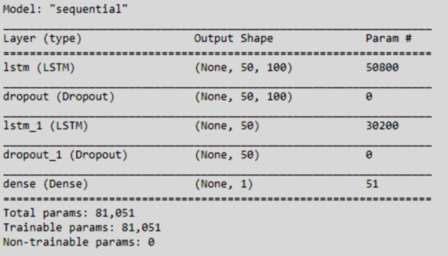
Predictive maintenance – Axbit’s solution
Pre-Analysis:
A. D. Fuller to test the null hypotheses
“Data is time stationary”.
RNN’s LSTM should do better in capturing the time dependent nonlinear patterns.
All features are non-stationary
LSTM network:
Sequence length (time units): 50.
Number of units (number of hidden states): 100.
Two LSTM blocks
Two dropout layers, both will drop 20% of the units.
A dense layer at the end with
‘Sigmoid’ activation function for binary classification.
‘Softmax’ for multiclass.
‘linear’ for regression.

Slide 16
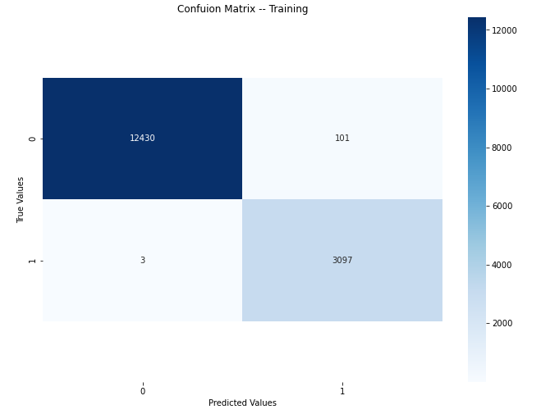
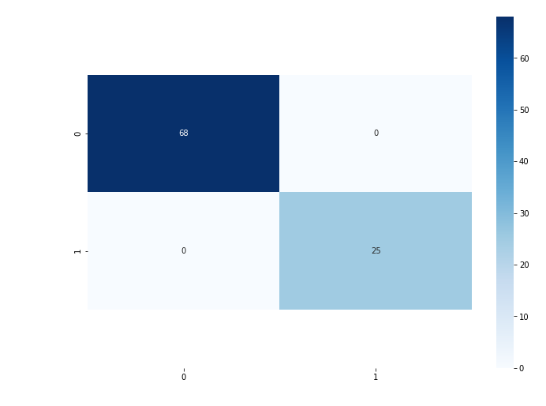
Binary classification
Confusion matrix - test data
If an in-service engine will fail in next w0 = 15 time-units window.

Slide 17
Binary classification
 | W0 =10 | W0 = 15
Accuracy | 0.96 | 1
Precision | 0.84 | 1
Recall | 1 | 1
F1-Score | 0.91 | 1

Slide 18
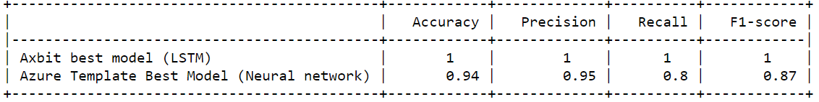
Predictive maintenance In-service aircraft engine
Regression: Predict the Remaining Useful Life (RUL).
Binary classification: Predict if an in-service engine will fail within certain time frame.
Multi-class classification: Predict if an in-service will fail in two different time windows.

Slide 19
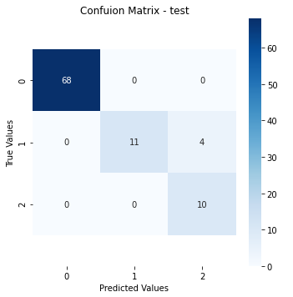
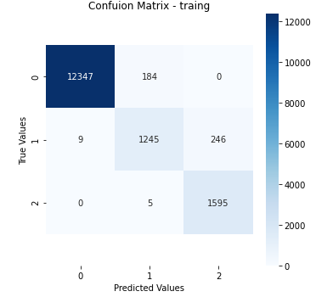
Multiclass classification
Class label = 1, If an in-service engine will fail in next w0 = 15 time-units window.
Class label = 2, if an in-service engine will fail within w0 and w1 = 30, w1 > w0.

Slide 20
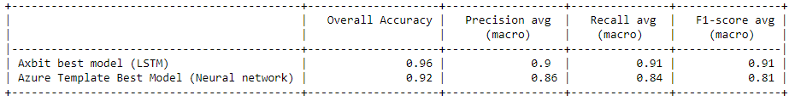
Predictive maintenance In-service aircraft engine
Regression: Predict the Remaining Useful Life (RUL).
Binary classification: Predict if an in-service engine will fail within certain time frame.
Multi-class classification: Predict if an in-service will fail in two different time windows.

Slide 21
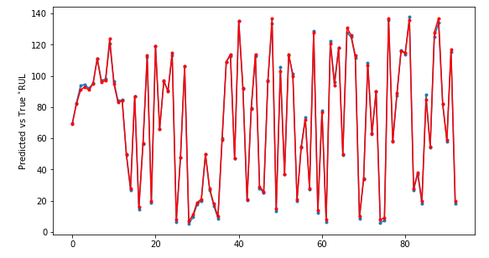
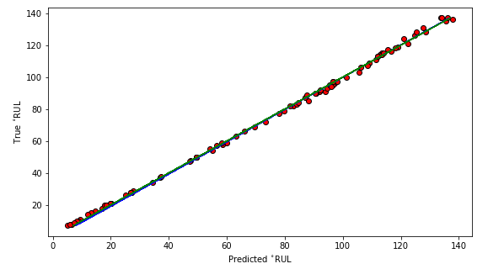
Regression

Slide 22
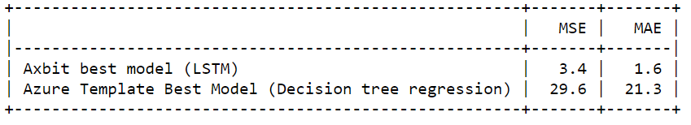
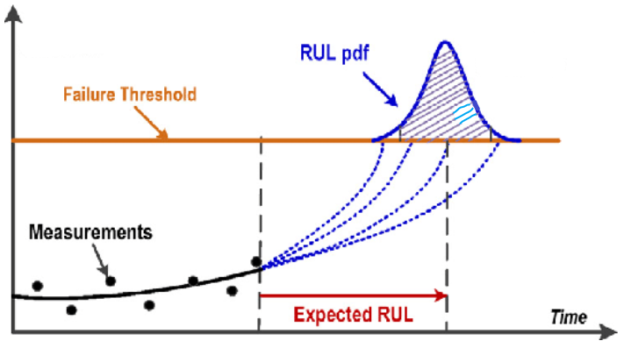
Predictive maintenance In-service aircraft engine
Regression: Predict the Remaining Useful Life (RUL).
Binary classification: Predict if an in-service engine will fail within certain time frame.
Multi-class classification: Predict if an in-service will fail in two different time windows.
Degradation indicator

